Slide 1

Clustering of Documents Based on Text Content
Clustering of Documents Based on Text Content
Niket Raj 1PI13CS100
S Bhaskar 1PI13CS128
Shreyash Patil 1PI13CS155
Guide :-
Prof. V R Badri Prasad

Slide 2
Clustering of Documents Based on Text Content
Problem Definition
Given a mixed set of documents of different computer science domains mainly networking , cloud computing ,mobile computing data mining ,classify or cluster these documents such that each domains related papers are together .The result is the given document belongs to which domain.

Slide 3
Clustering of Documents Based on Text Content
Deliverables
Term Document matrix having words, its count and in the document in which it is present.
Dimensionality reduction over the frequency matrix in order to derive a matrix of lesser dimension.
Classification of the clusters and labeling.
Development and updating of database of corpus with new dataset.

Slide 4
Clustering of Documents Based on Text Content
Methodology
Dataset input
Term
Document Matrix
TCFS
Clusters with
Labels

Slide 5


Clustering of Documents Based on Text Content
System Architecture
Proposed System
User
Database of Corpus
DataSet
Fig. High Level Architecture of System

Slide 6
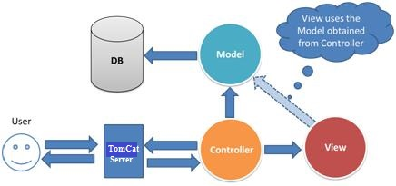
Clustering of Documents Based on Text Content
System Architecture
Architecture of System

Slide 7
Clustering of Documents Based on Text Content
Implementation Plan
Parsing the data for provided dataset,
Ontology Based Term Analysis using NLP.
Form Term Document Matrix having words, its count and in the document in which it is present.
Text clustering algorithm TCFS (Text Clustering with Feature Selection) to identify relevant features and train the system.

Slide 8
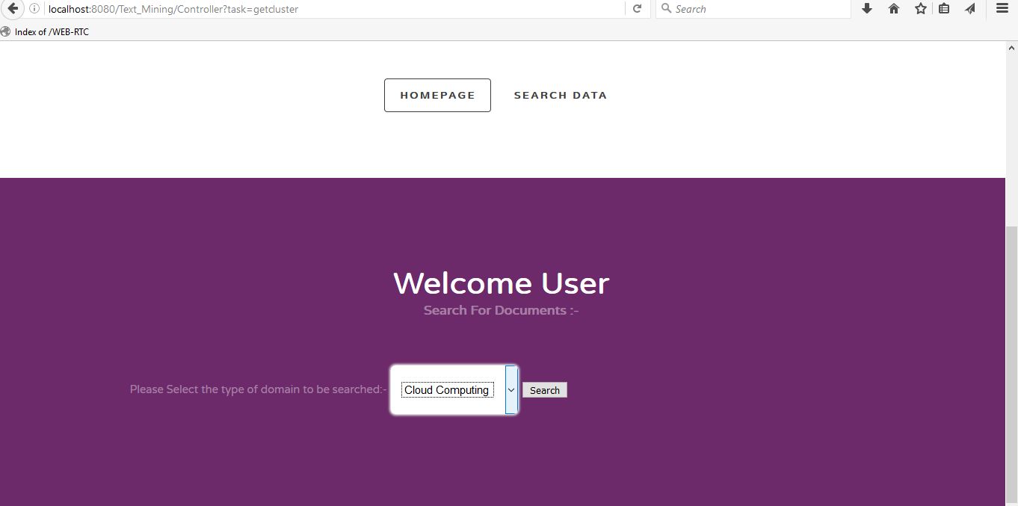
Clustering of Documents Based on Text Content
Screenshots - 1

Slide 9
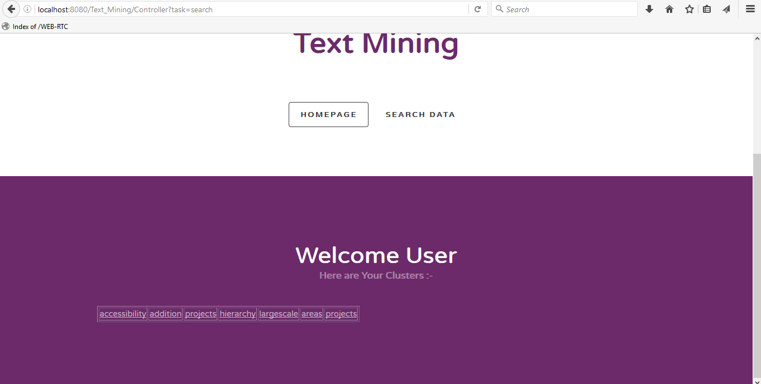
Clustering of Documents Based on Text Content
Screenshots - 2

Slide 10
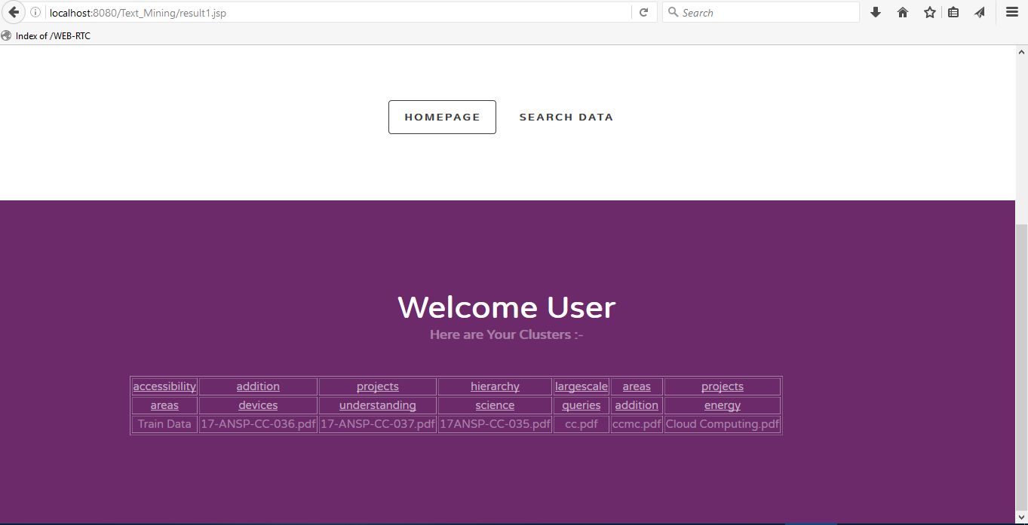
Clustering of Documents Based on Text Content
Screenshots – 3

Slide 11
Clustering of Documents Based on Text Content
Real World use case
For Researcher who spends a lot time on Literature survey
Efficient Search Results
Provides additional information to the various
Semantic applications and Developers.

Slide 12
Clustering of Documents Based on Text Content
Challenges faced
Data Set Collection for Different Domains.
Algorithm Selection for Implementation like K-means Clustering Algorithm, SVM (Support Vector Machine) and TCFS.
Infrastructure for training the system.

Slide 13
Clustering of Documents Based on Text Content
Future Enhancements
Clustering and feature selection system can be upgraded to process all type of documents such as rich text format (RTF) documents.
The Final Clustered Documents should be Portable.
System should Implement Multithreading Concept for Training in order to give faster Results.

Slide 14
Clustering of Documents Based on Text Content
References
Zhao, Y. and Karypis, G., “Clustering Algorithms for Document Datasets”, Data Mining and Knowledge Discovery [C].10(2), pp.141-168, 2005.
Liu, F. and Xiong, L., “Survey on text clustering algorithm -Research present situation of text clustering algorithm” IEEE 2nd International Conference on Software Engineering and Service Science (ICSESS), pp.196-199, 2011.
Zhao, Y., and Karypis, G., “Evaluation of Clustering algorithms for documentdatasets”, International Conference on Information and Knowledge Management, McLean,Virginia, United States, pp.515-524, 2002.

Slide 15
Clustering of Documents Based on Text Content
Thank You….

